Slide 1
IPL Analysis
Indian premier league(IPL) is a professional 20-20 cricket league in India contested annually by franchise teams representing Indian cities. The IPL is the most-attended cricket league in the world and ranks sixth among all sports leagues .
In this analysis I work thorough the entire sports intelligence workflow :- connecting and shaping the data , adding calculated fields, creating parameters and designing an interactive storyline .

Slide 2
Steps :-
Connecting and Shaping the data .
Building a relational model .
Adding calculated fields .
Creating parameters .
Designing the dashboards .
Draws the insights .
Creating the storyline .

Slide 3
Tools Used :-
Python(Pandas) is used to clean the data .
SQL for data extraction and transformation .
Tableau for dashboard development and making storyline .
SQL , Tableau , Python .

Slide 4
Preprocessing Steps / Cleaning :-
1) load the dataset :
See the dataframe ,see general attributes .
Now do the data cleaning and remove the null values and duplicates .
2) Handling the city columns :
Replace the null values of city regarding the venue they are present .
3) Handling the date columns:
First of all change the datatype of the date column from the object to datetime .
Creating the season column using the date column .
4) Handling the player of match column :
Replace the null values of player of match column with ‘NO Player Of Match’ .

Slide 5
5) Handling the winner column :
Replace the null values of winner column with ‘No Winner’ .
6) Handling the result column :
Replace the null values of result column with ‘No Result’ .
7) Handling the result margin column :
Replace the null values of result margin column –
0 where result = tie
‘match abandon’ where result = No result
8) Handling the eliminator column:
Replace the null values of eliminator column with Mode .

Slide 6
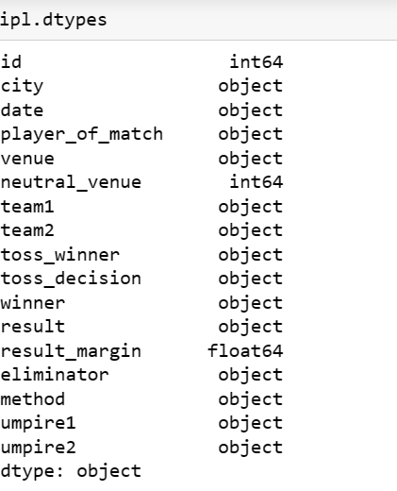
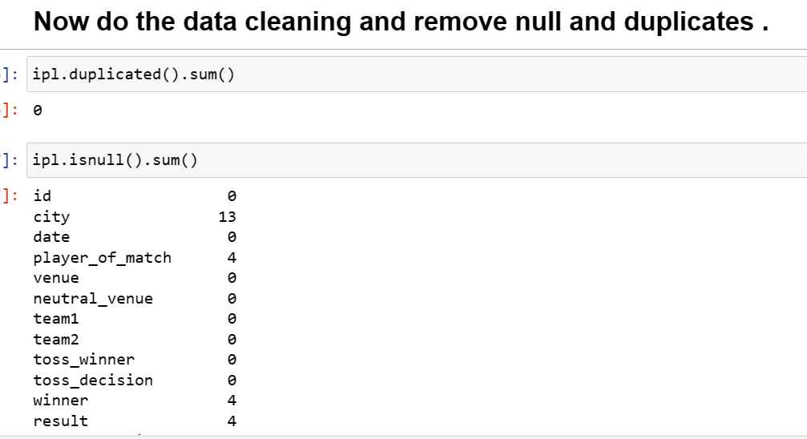
9) Handling the method column :
Replace the null values of method column with ‘No Method’ .

Slide 7
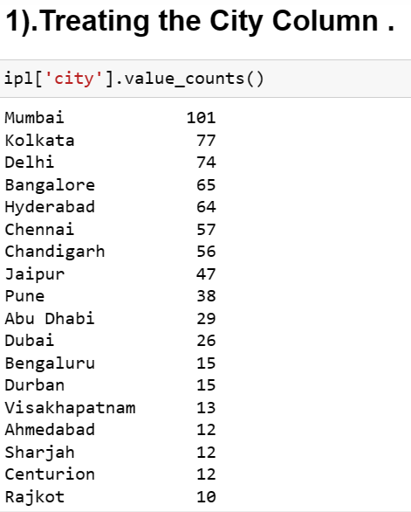
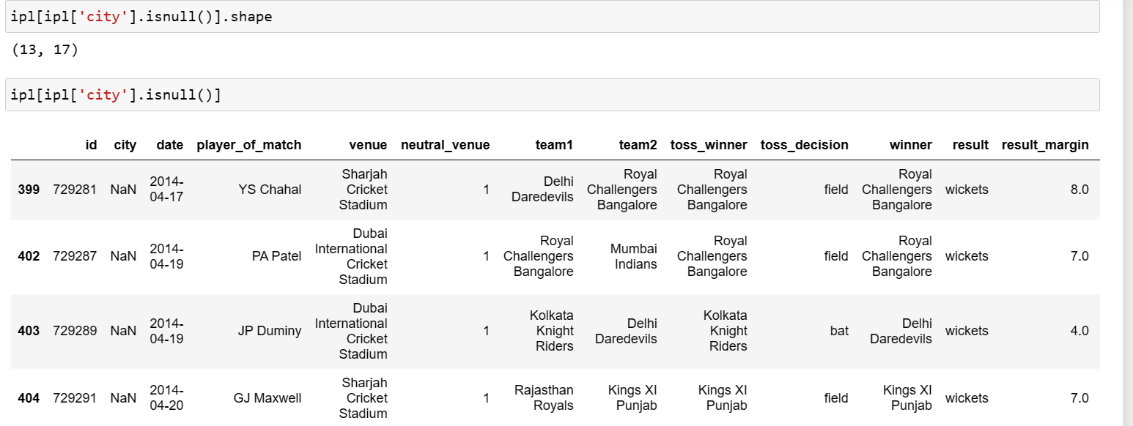
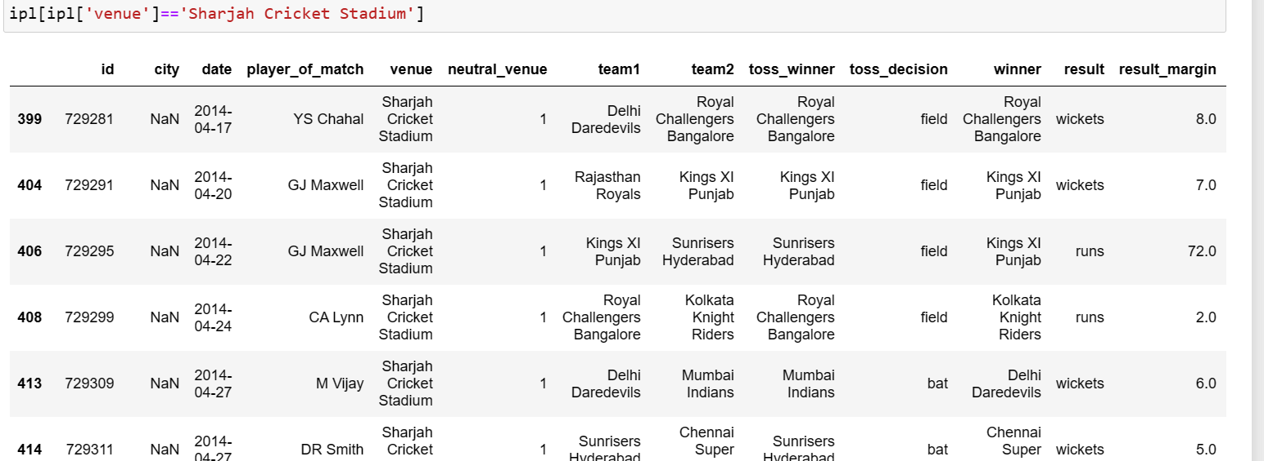

Slide 8
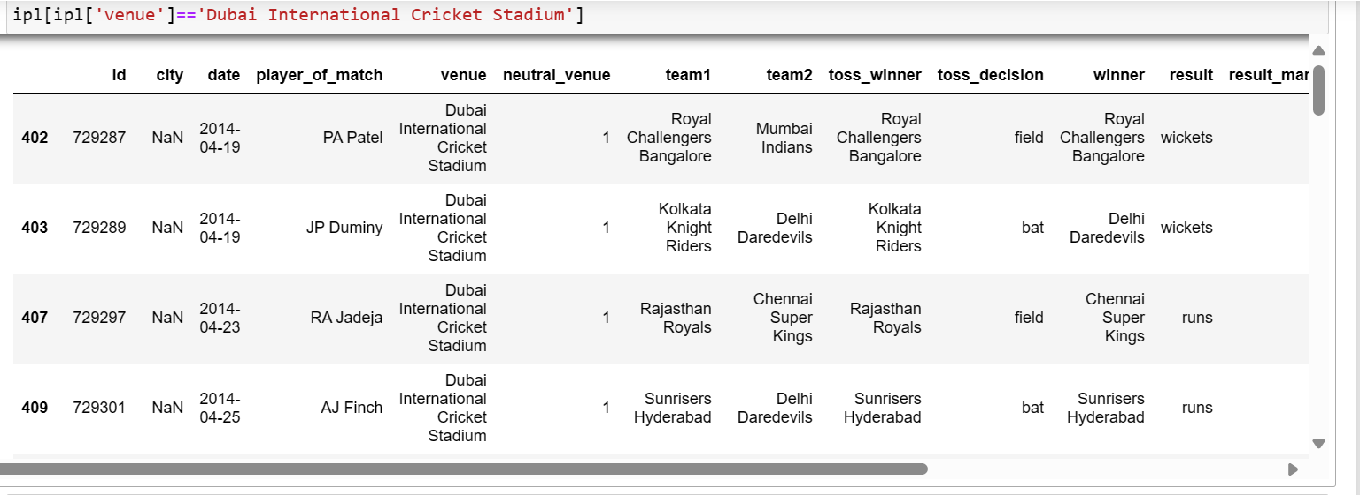
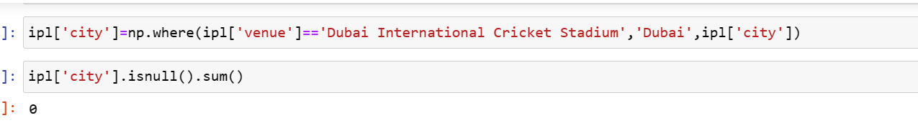

Slide 9
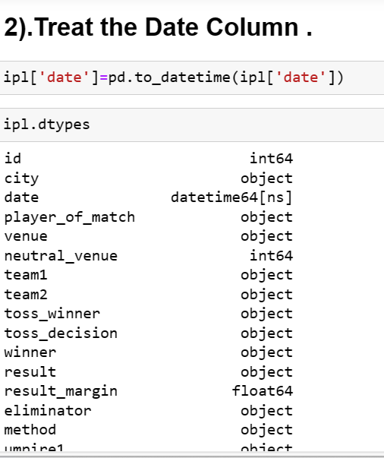
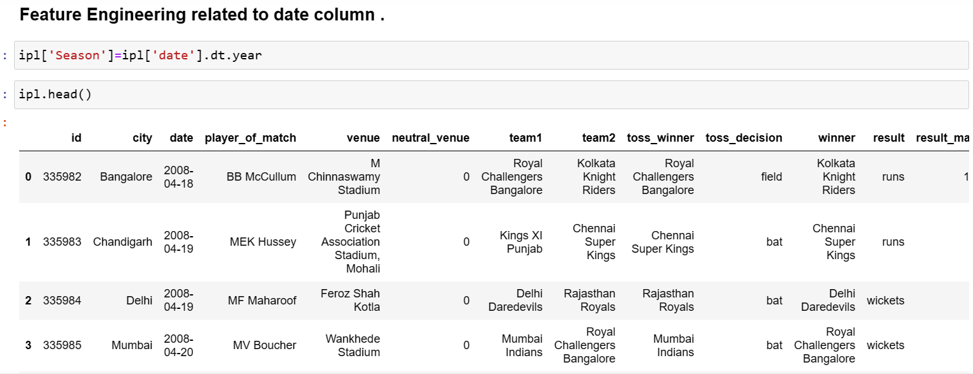

Slide 10
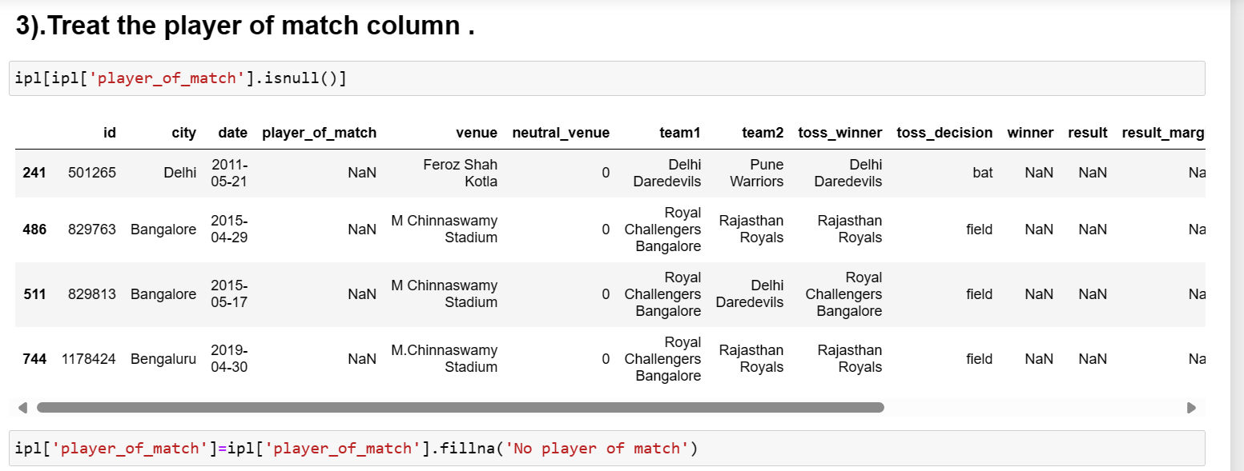
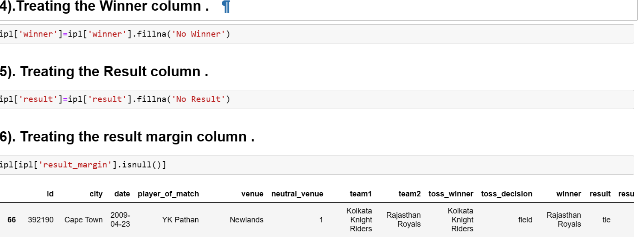

Slide 11
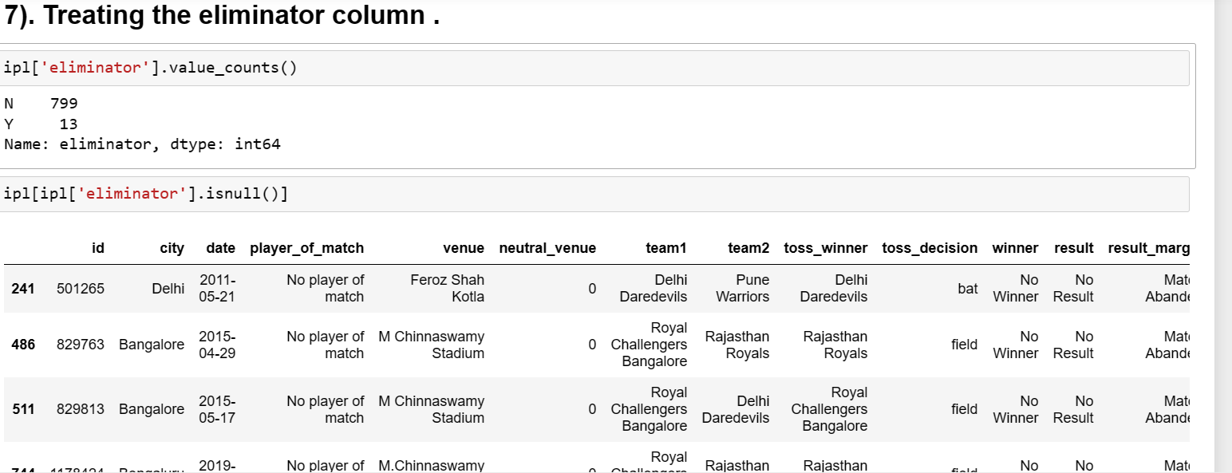
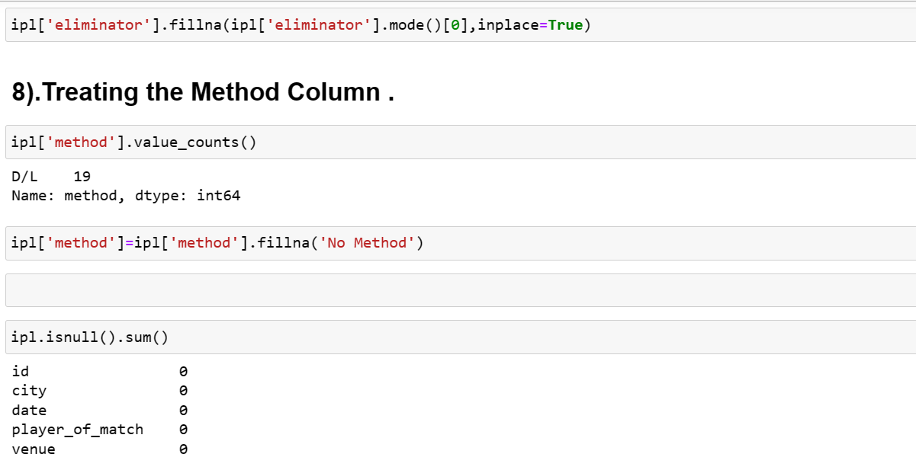

Slide 12
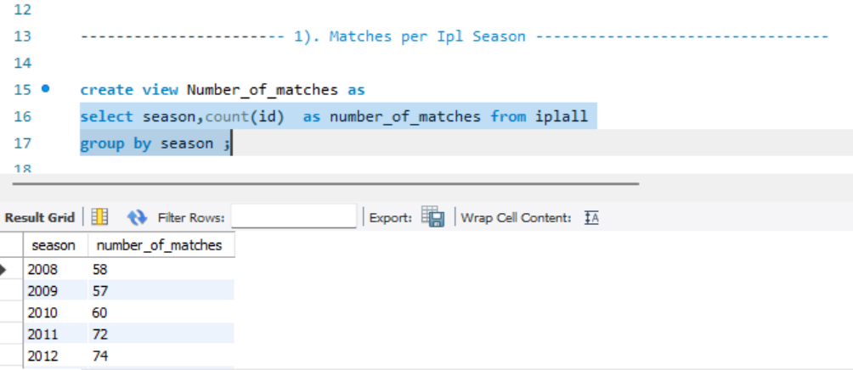
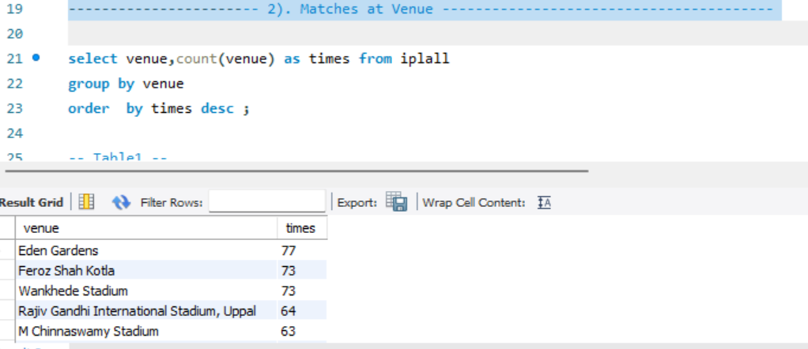
SQL Queries

Slide 13
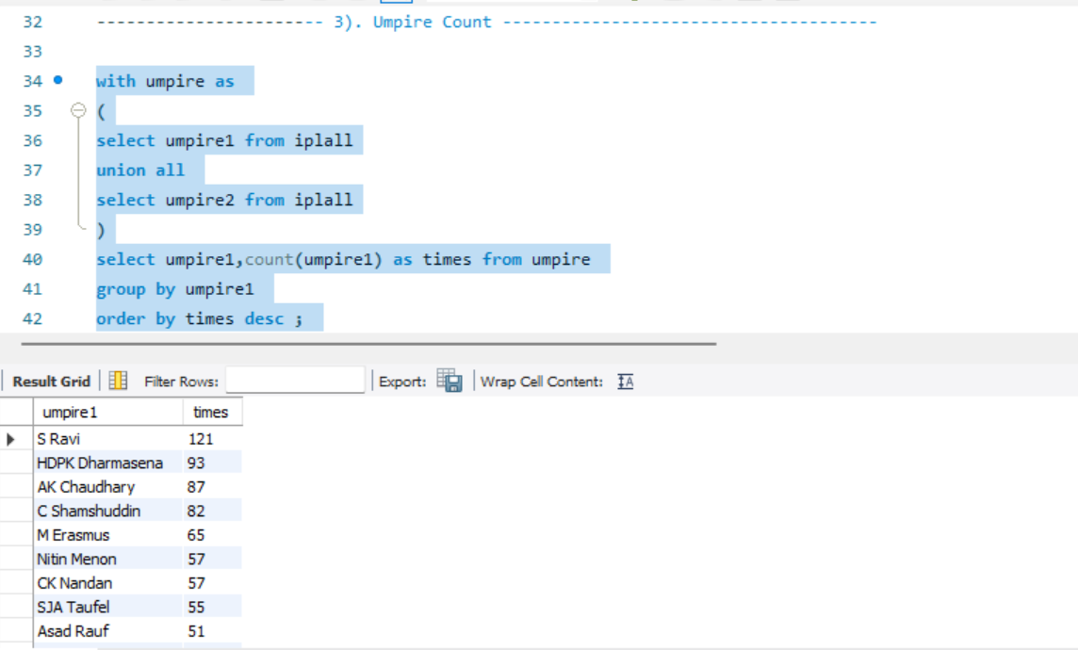
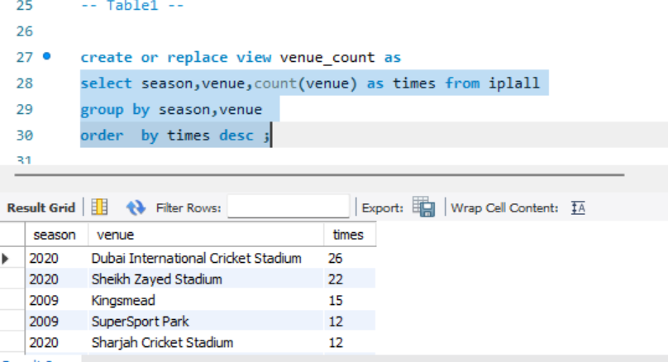

Slide 14
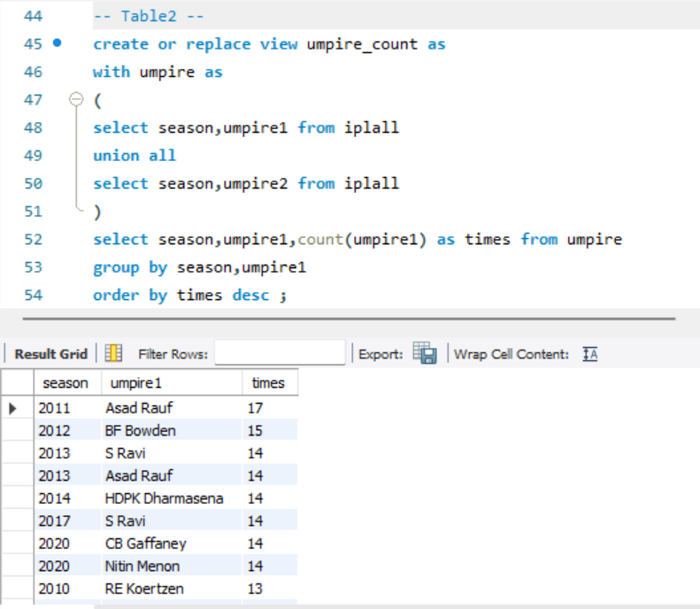
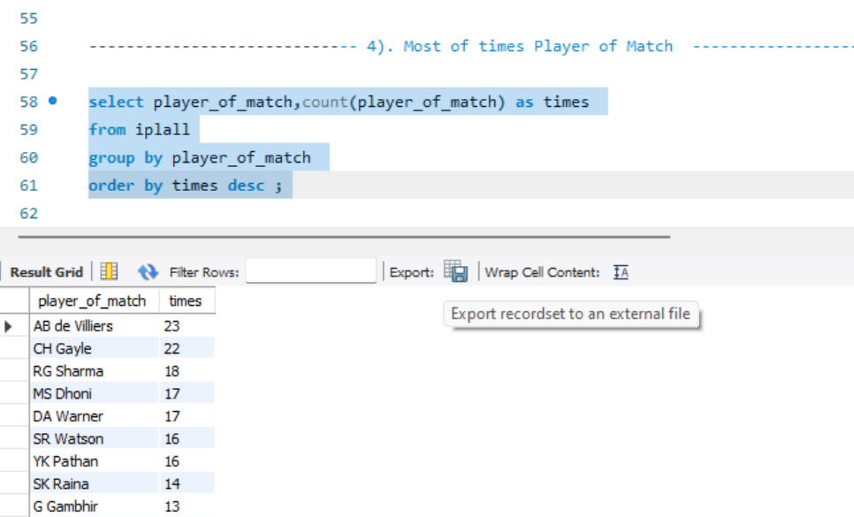

Slide 15
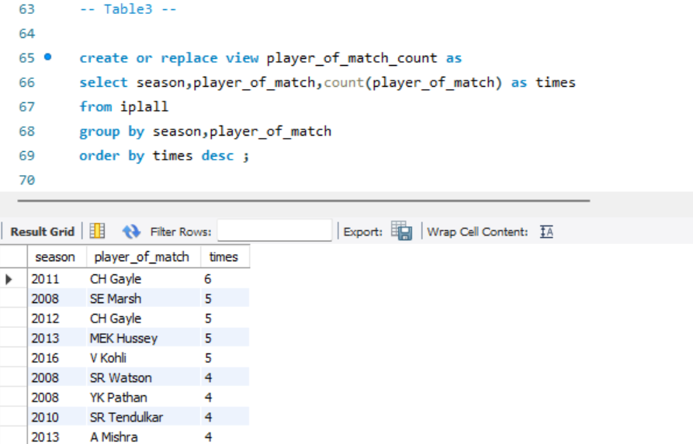
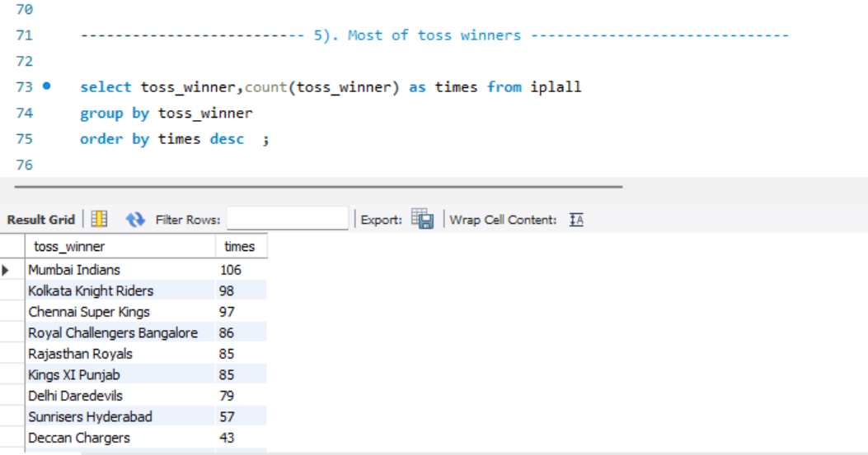

Slide 18
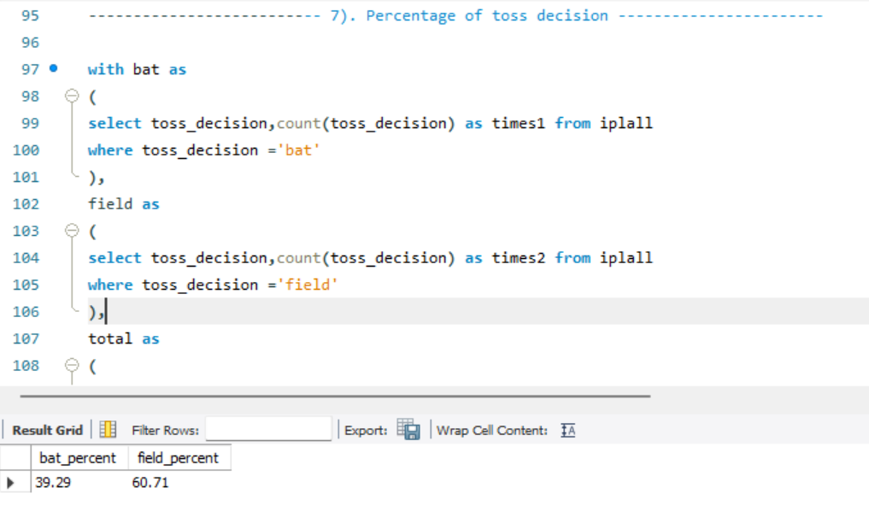
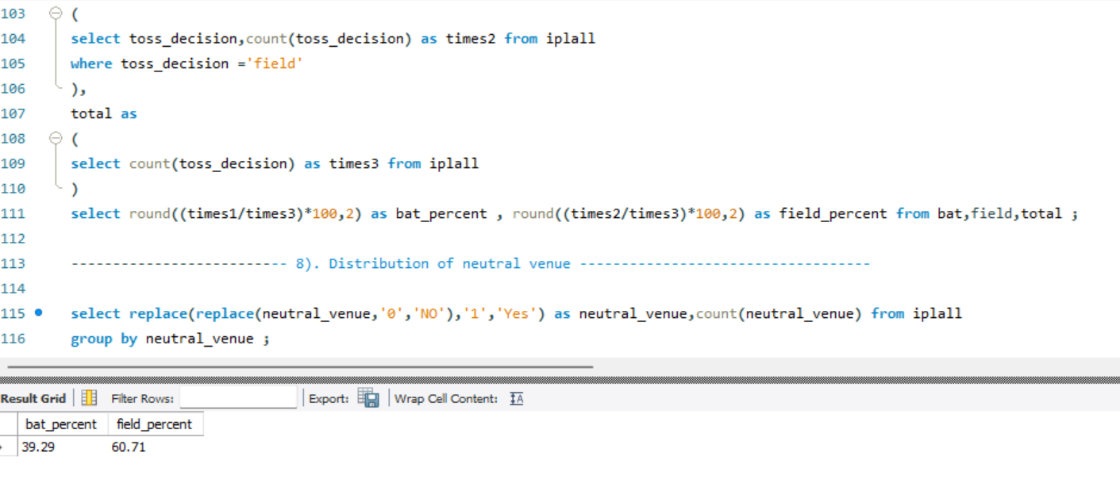

Slide 19
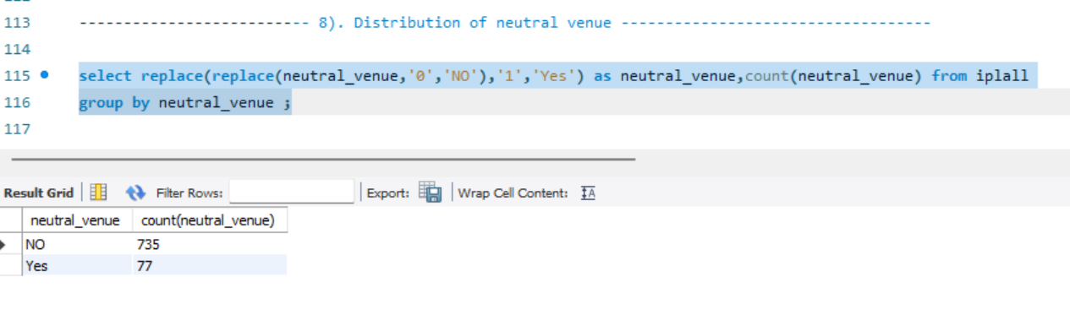
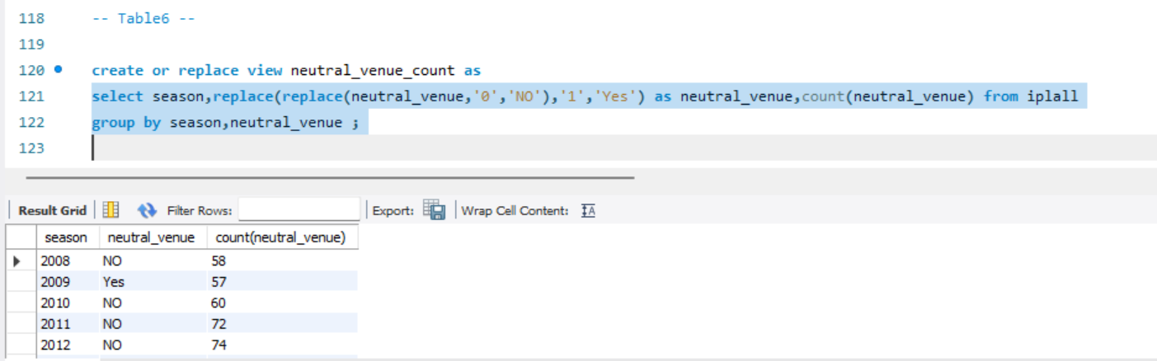

Slide 20
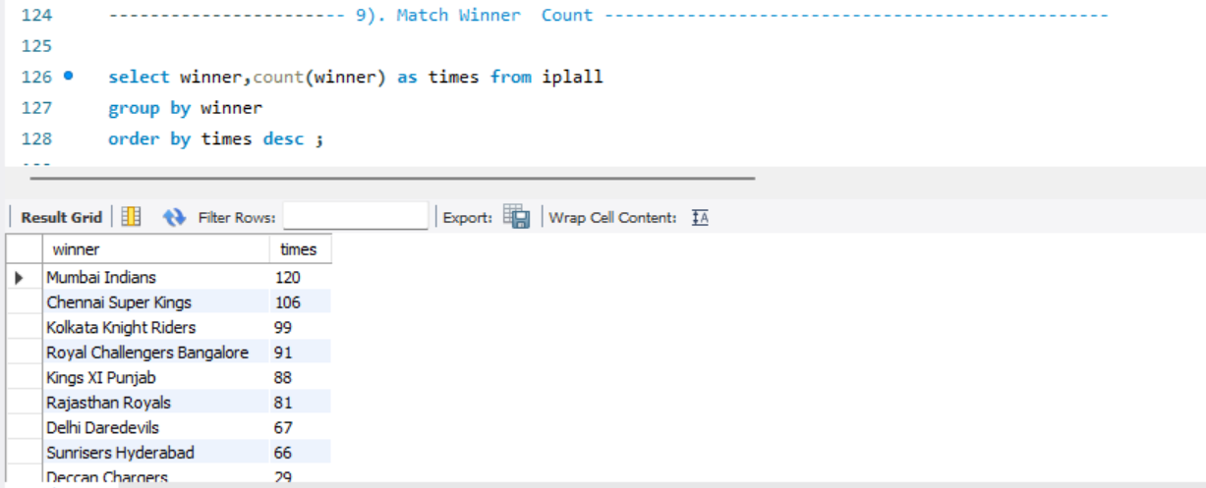
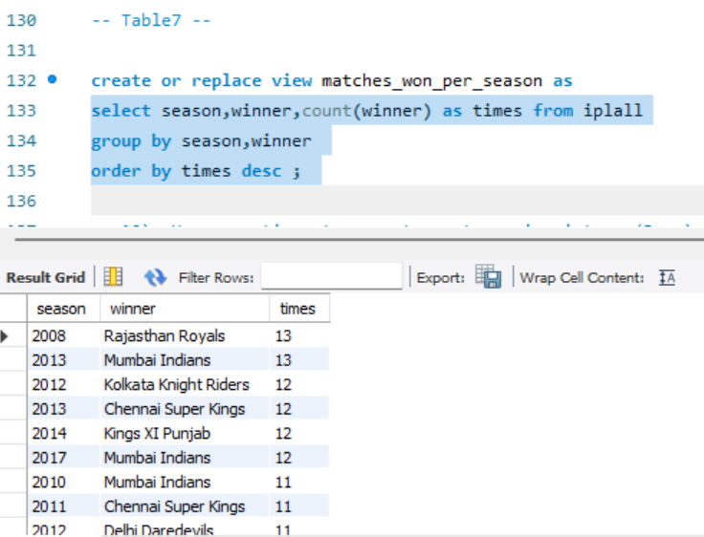

Slide 21
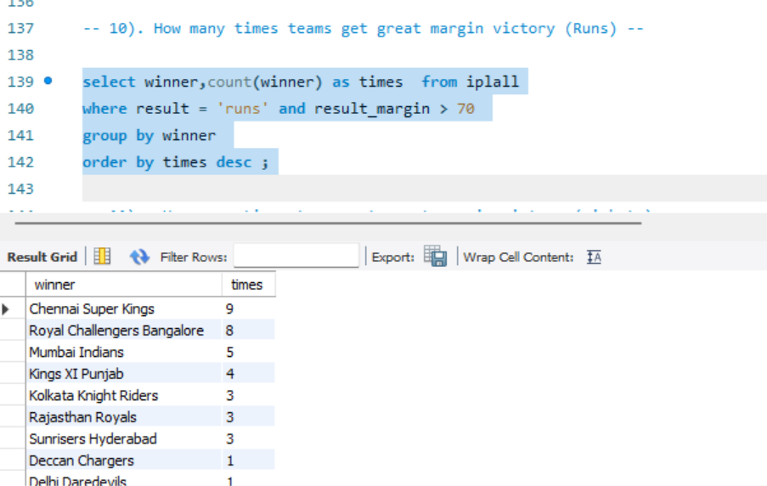
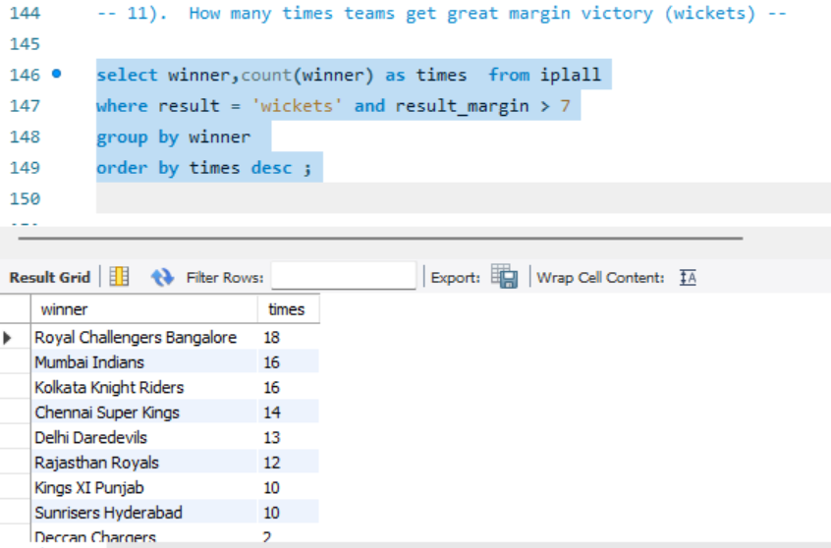

Slide 22
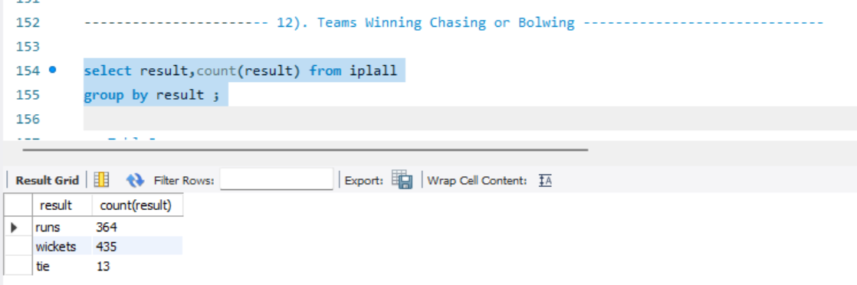
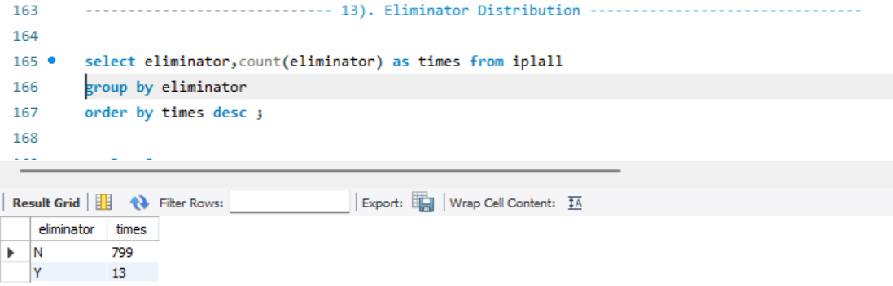
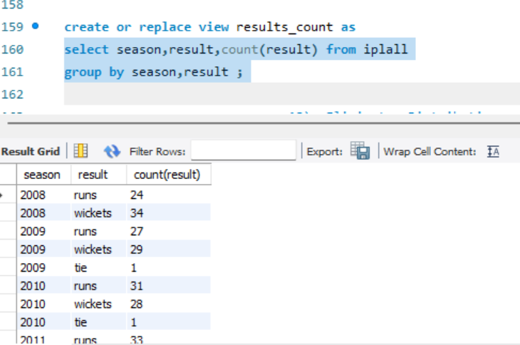

Slide 23
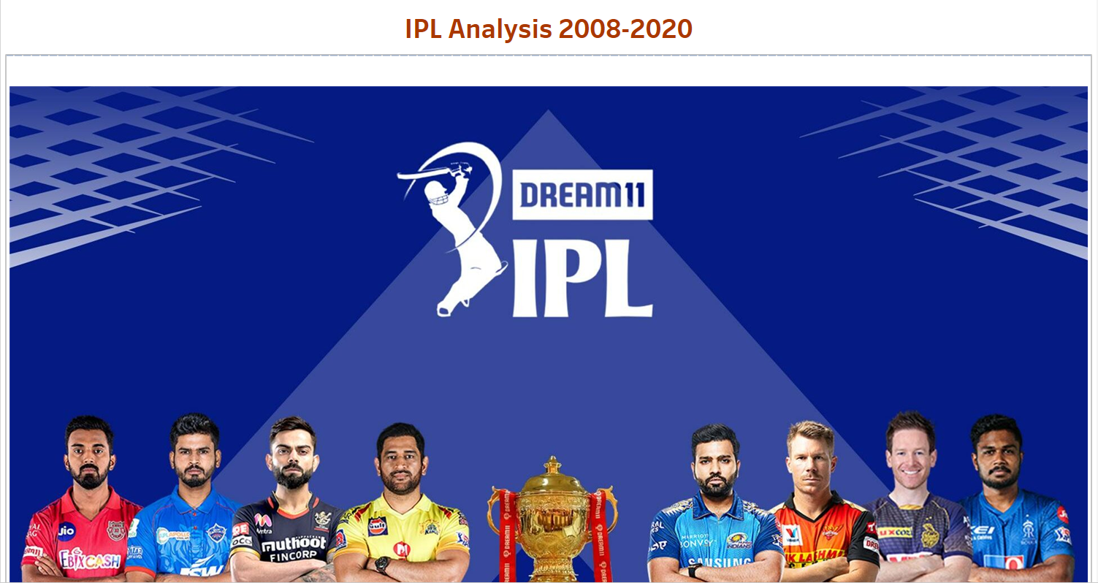
Tableau

Slide 24
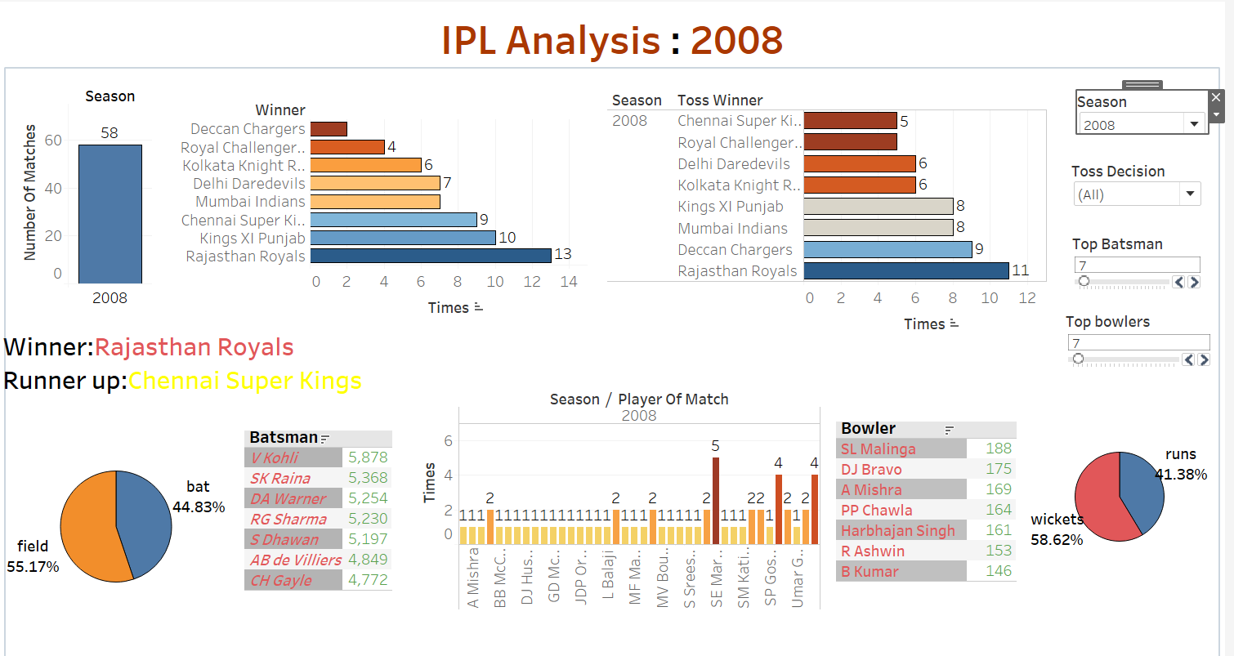

Slide 25
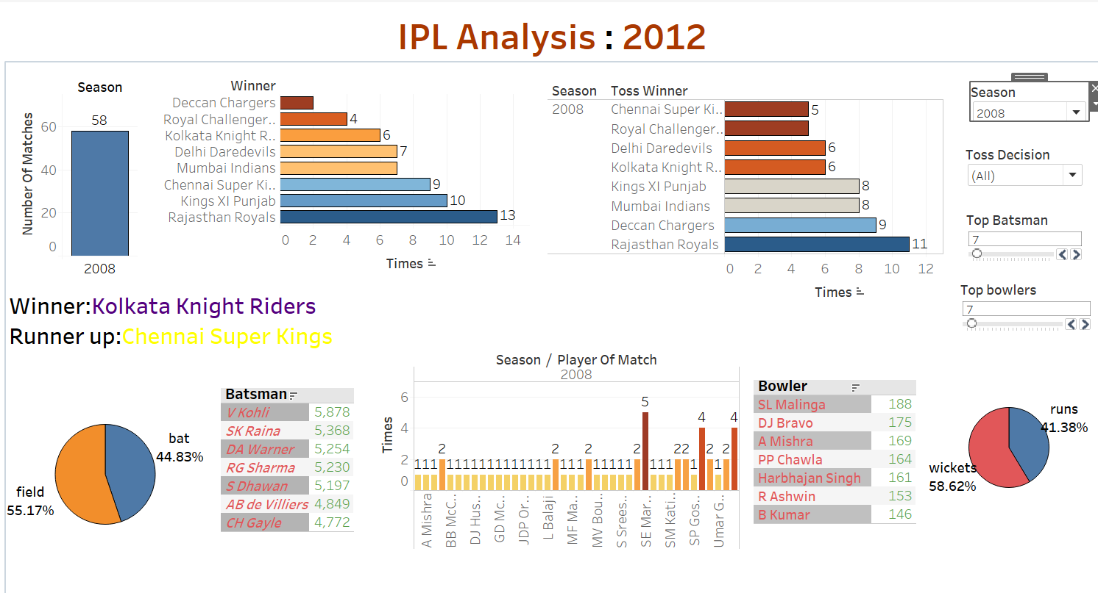

Slide 26
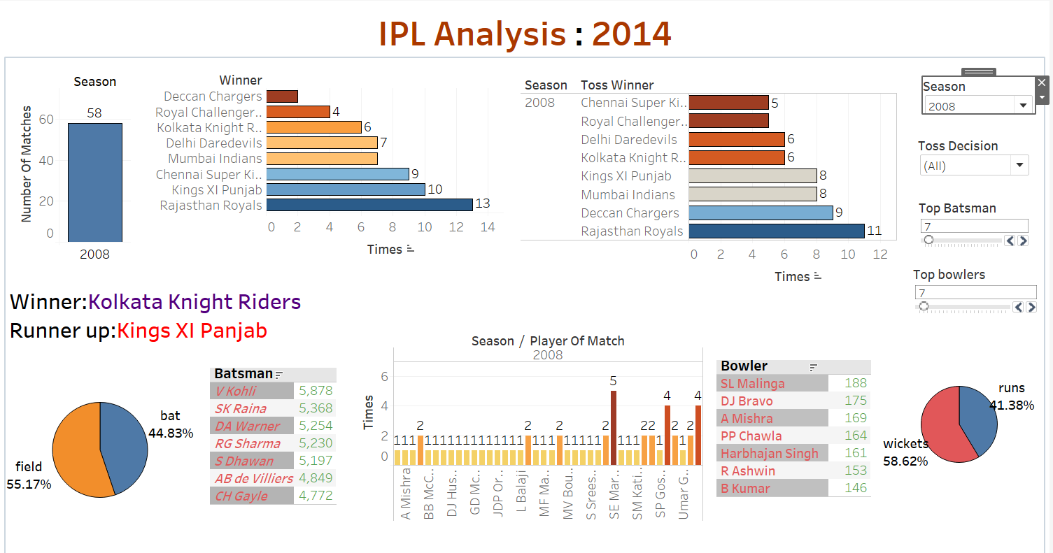

Slide 27
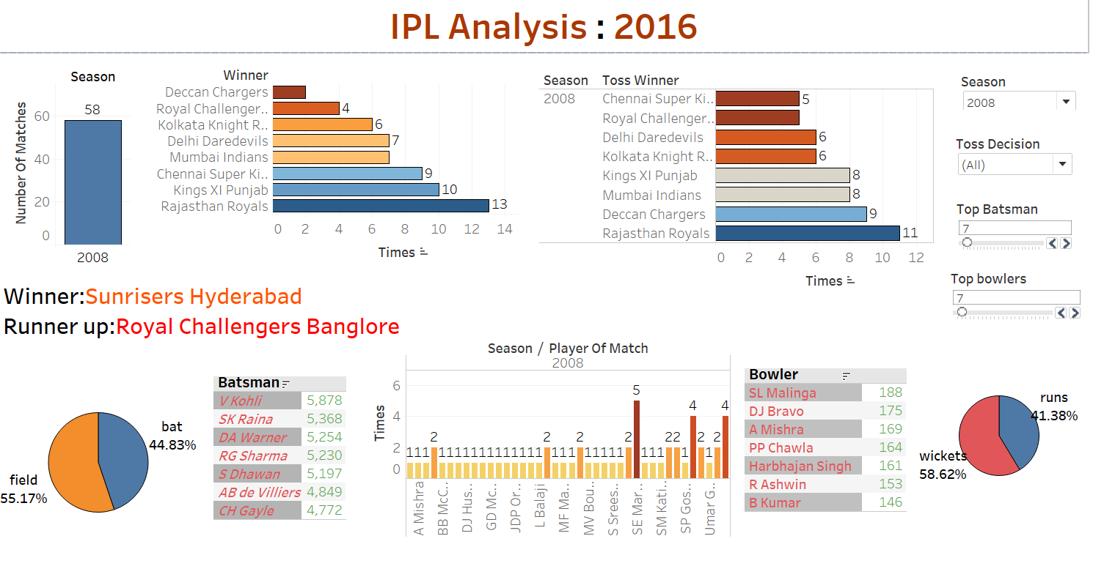

Slide 28
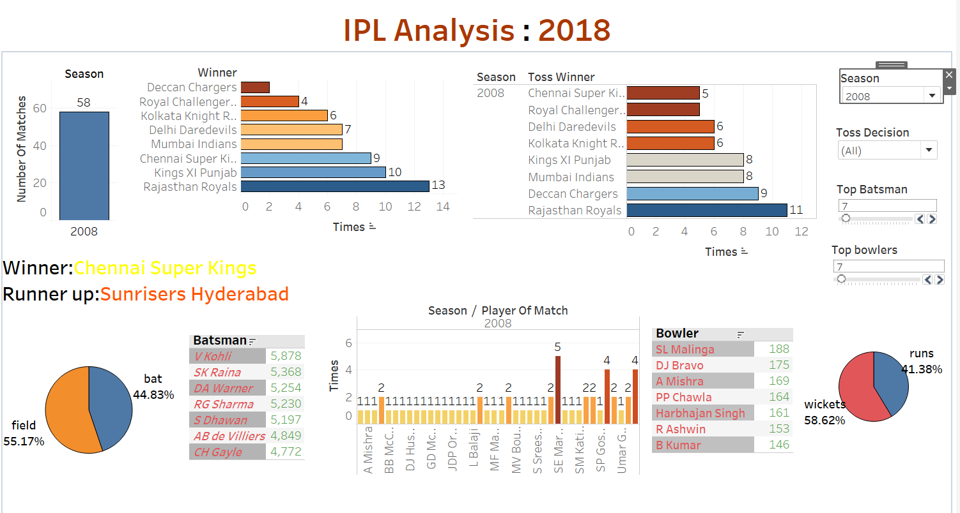

Slide 29
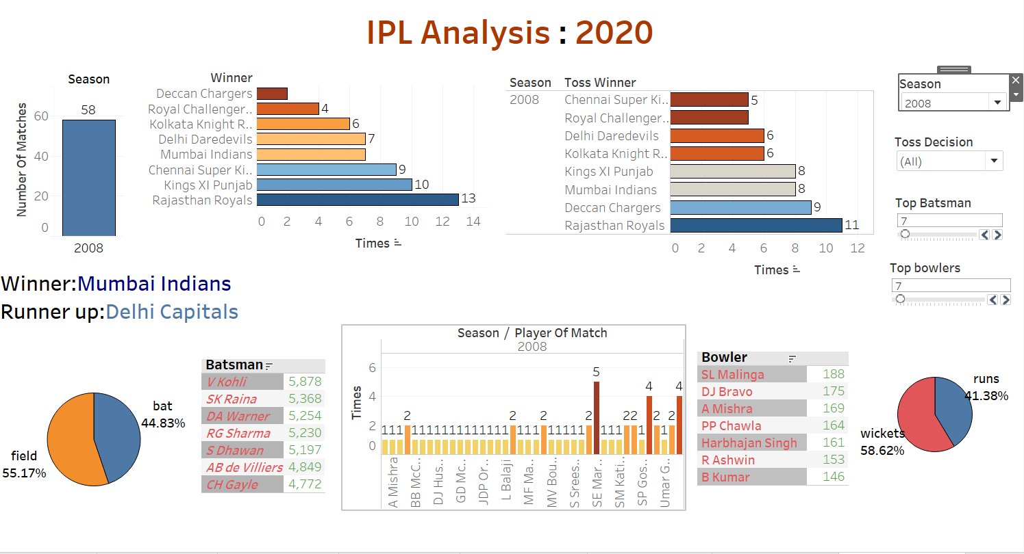

Slide 30
References :-
Documentation of Tableau .
Get Started – Tableau .
Dataset from Kaggle .
https://www.kaggle.com/datasets/ukveteran/maven-market-datasets .
Documentation of MySQL .
MySQL :: MySQL Documentation .

